Slide 1

PaperTree:
A Research Paper Recommender
MidTerm Presentation
Team : Nexus
Anjali Verma
Malvika Singh
Ritika Ahuja

Slide 2

About
PaperTree provides its user with multitude of research papers to study.
In addition, it also recommends papers to study to the users based upon their interest and history of readings.
In addition to recommending papers, the application also allows the user to mark the papers, it adds them to their “Saved Papers”, and then they the user can access them directly.

Slide 3
Architecture
User Interface
Network
SERVER SIDE OF APPLICATION
LOAD BALANCING SERVER
Amazon Elastic Map Reduce
Local Data Stores
Database

Slide 4
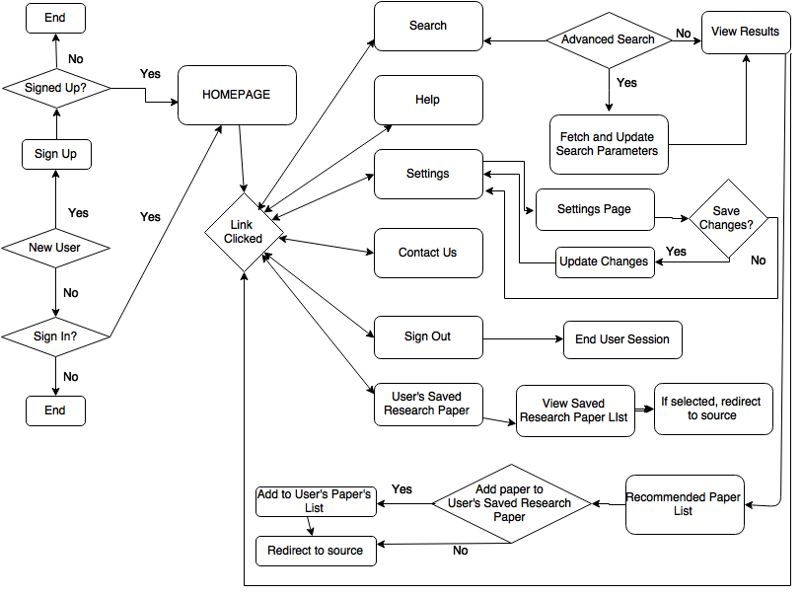
Flow Chart

Slide 5
Use Case Diagram (for User)
Authenticate
Login / Sign Up
Change Email
Settings
Change Password
Search
Results
User
Recommendations
User Profile
Sign Out
Achieved Papers
Name
Recommendations
Email Address
Areas of Interest

Slide 6
Use Case Diagram (for Administrator)
Authenticate
Login / Sign Up
Change Email
Settings
Change Password
Administrator Profile & Controls
Administrator
Upload New Paper
Sign Out
Name
Delete Paper
Email Address
Modify Paper

Slide 7
Modules
Access Module:
This module consists of Login, Sing Up and Authentication.
Search Module:
This module consists of search and advanced search.
Recommender Module:
This module is the core of the application and performs the task of recommending paper to users based on their interests and access history.
Settings Module:
This module consists of feature to allow and change the Email address and Password associated with an user account.

Slide 8
Data Set Link
http://www.comp.nus.edu.sg/~sugiyama/SchPaperRecData.html
Data is described as feature vectors.
Two Types of data sets available-
Data Set 1 (Large Dataset)- 100,531 papers, 50 researcher’s interest.
Data Set 2 ( Small Dataset)- 597 papers, 15 junior & 13 senior researcher’s interest.

Slide 9
Data Structure & SDLC
1. Data Structure to store the Matrix : Hash Map Set with key value pair as Integer (userid) and List of Integers (Papers read by that user).
2. SDLC Model- Mixture of Prototype and V Model

Slide 10
Algorithms
1. Collaborative Filtering:
We first construct a matrix that maps whether a user U(i) has read a paper P(j)or not. If the user has, we mark Matrix(i , j)=1 else it is marked 0.

Slide 11
Algorithms (User x Paper Matrix)
 | P1 | P2 | P3 | P4 | P5 | P6 | P7 | P8 | P9 | P10 | P11 | P12 | P13 | P14 | P15 | P16 | P17 | P18
U1 | 0 | 1 | 0 | 1 | 1 | 0 | 0 | 0 | 0 | 0 | 1 | 0 | 1 | 1 | 0 | 0 | 0 | 0
U2 | 0 | 1 | 0 | 0 | 0 | 1 | 1 | 0 | 0 | 0 | 1 | 0 | 1 | 1 | 0 | 0 | 0 | 1
U3 | 1 | 1 | 0 | 0 | 0 | 0 | 0 | 0 | 0 | 0 | 0 | 0 | 0 | 0 | 0 | 0 | 0 | 0
U4 | 0 | 1 | 0 | 1 | 1 | 0 | 1 | 0 | 0 | 0 | 0 | 1 | 0 | 1 | 0 | 1 | 1 | 0
U5 | 1 | 0 | 1 | 0 | 1 | 0 | 1 | 0 | 1 | 0 | 0 | 0 | 0 | 0 | 0 | 0 | 0 | 1
U6 | 1 | 1 | 0 | 0 | 1 | 1 | 0 | 0 | 0 | 0 | 0 | 1 | 1 | 0 | 0 | 0 | 1 | 0
U7 | 0 | 0 | 0 | 0 | 0 | 0 | 0 | 0 | 0 | 0 | 1 | 0 | 1 | 1 | 0 | 0 | 0 | 1

Slide 12
Algorithms
The first step generates a sparse matrix that consumes a lot of memory, so we need to create subspace matrix.
For that, we create clusters where for each user we store only those paper ID’s that the user has read, thus saving a lot of space.

Slide 13
Algorithms (Subspace Clusters)
U1 | P2 | P4 | P5 | P11 | P13 | P14
U2 | P2 | P6 | P7 | P11 | P13 | P14 | P18
U3 | P1 | P2
U4 | P2 | P4 | P5 | P7 | P12 | P14 | P16 | P17
U5 | P1 | P3 | P5 | P7 | P9 | P18
U6 | P1 | P2 | P5 | P6 | P12 | P13 | P17
U7 | P11 | P13 | P14 | P18

Slide 14
Algorithms
Then, we process the clusters to remove redundancy. For every cluster two cluster we combine into one, we realize that the two users have same interests.

Slide 15
Algorithms (Removing Redundancy)
U1 : 2 4 5 11 13 14
U2 : 2 6 7 11 13 14 18
U3 : 1 2
U4 : 2 4 5 7 12 14 16 17
U5 : 1 3 5 7 9 18
U6 : 1 2 5 6 12 13 17
U7 : 11 13 14 18
C1 : 2 11 13 14
C2 : 2
C3 : 2 4 5 14
C4 : 5
C5 : 2 5 13
C6 : 2 14 7
……. So on.
Now we will compare the clusters formed, and we will remove the clusters which are completely a part of some other cluster.

Slide 16
Algorithms
For recommending, we compare the paper read by the user with the clusters generated above, the cluster that has the maximum common elements with the user is recommended.

Slide 17
Algorithms (Recommending Papers)
Let us assume that the current user in session is U. We scan the database to find out which papers U has read. Suppose U has read 2, 12 and 17. Then. We scan the cluster and determine the number of papers U and Cluster C(i) have in common.
C1 : 1
C2 : 1
C3 : 3
C4 : 0
C5 : 3
Since, C3 and C5 have same number of common elements with U. But length(C3)>length(C5). We first recommend the elements of C3, then elements of C5, then C2, then C1.

Slide 18
Success Evaluation Criteria
CRITERIA | COMMENTS
Prediction Accuracy | How accurately do the recommendation provided by the application relate to user’s interests and past reading.
Understand-ability | How easy is it to understand and learn the application? A complex structured UI will make it difficult for users to interact with the application.
Low Redirection Failure Rate | How many times does the application redirects user to destination that doesn’t exist or has been modified? Having a low redirection failure rate means better user experience.
Speed | An application that delivers on all the features and still be able to function smoothly without any bugs.

Slide 19
Success Evaluation Criteria
CRITERIA | COMMENTS
Precision | In a text search for a recommendation paper, precision is the number of correct results divided by the number of all returned results. Precision= (relevant ∩ retrieved)/retrieved
Security | Protecting the user’s profile and data during all stages of the application. Also, making sure that a user without proper credential doesn’t get to use the application.
Recall | In a text search on a set of documents recall is the number of correct results divided by the number of results that should have been returned. Recall= (relevant ∩ retrieved)/relevant

Slide 20
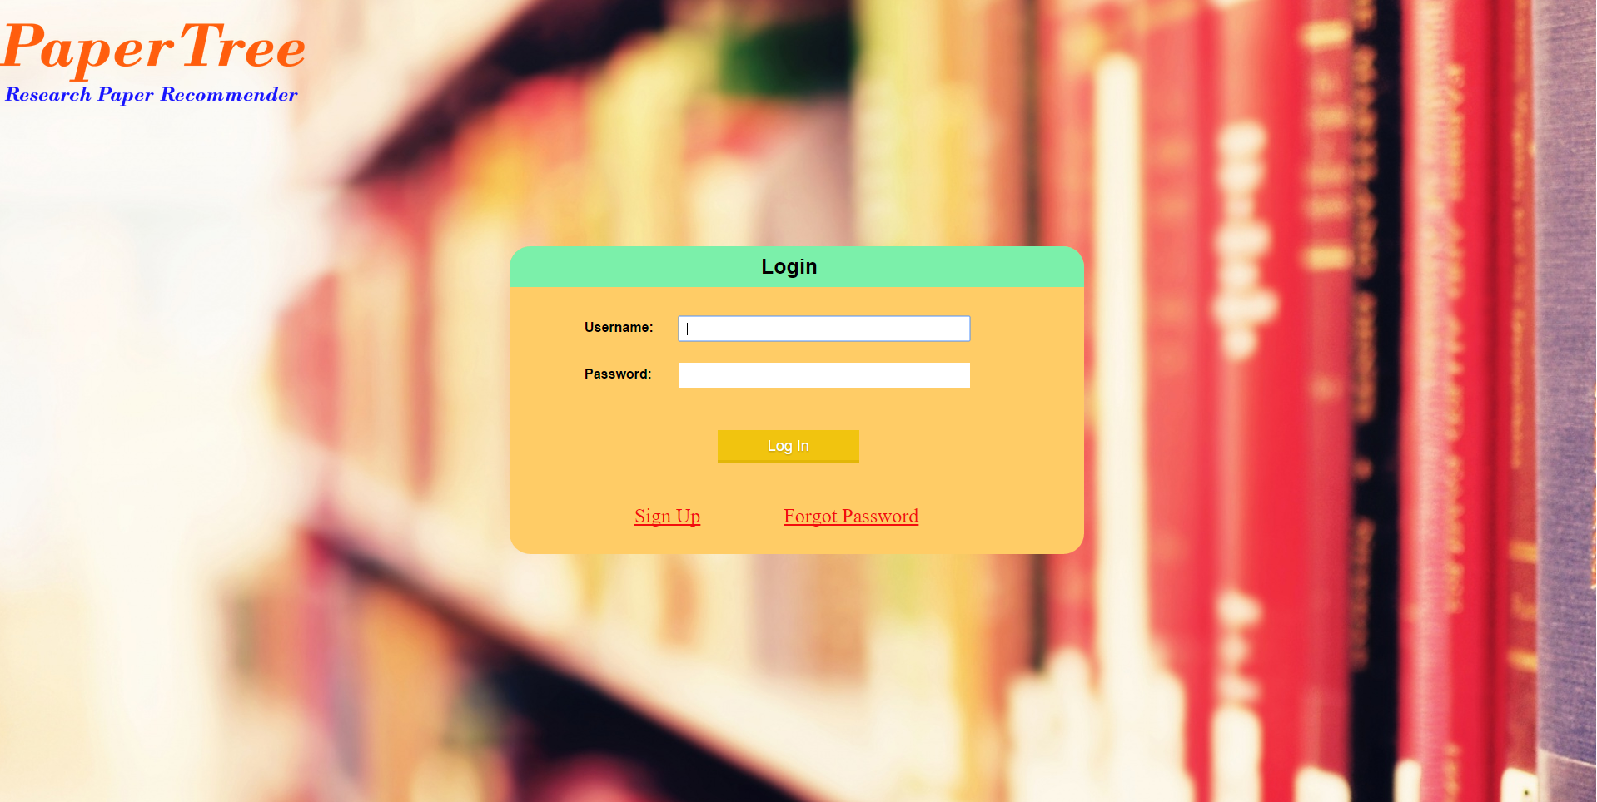
Screenshots
Home Page:

Slide 21
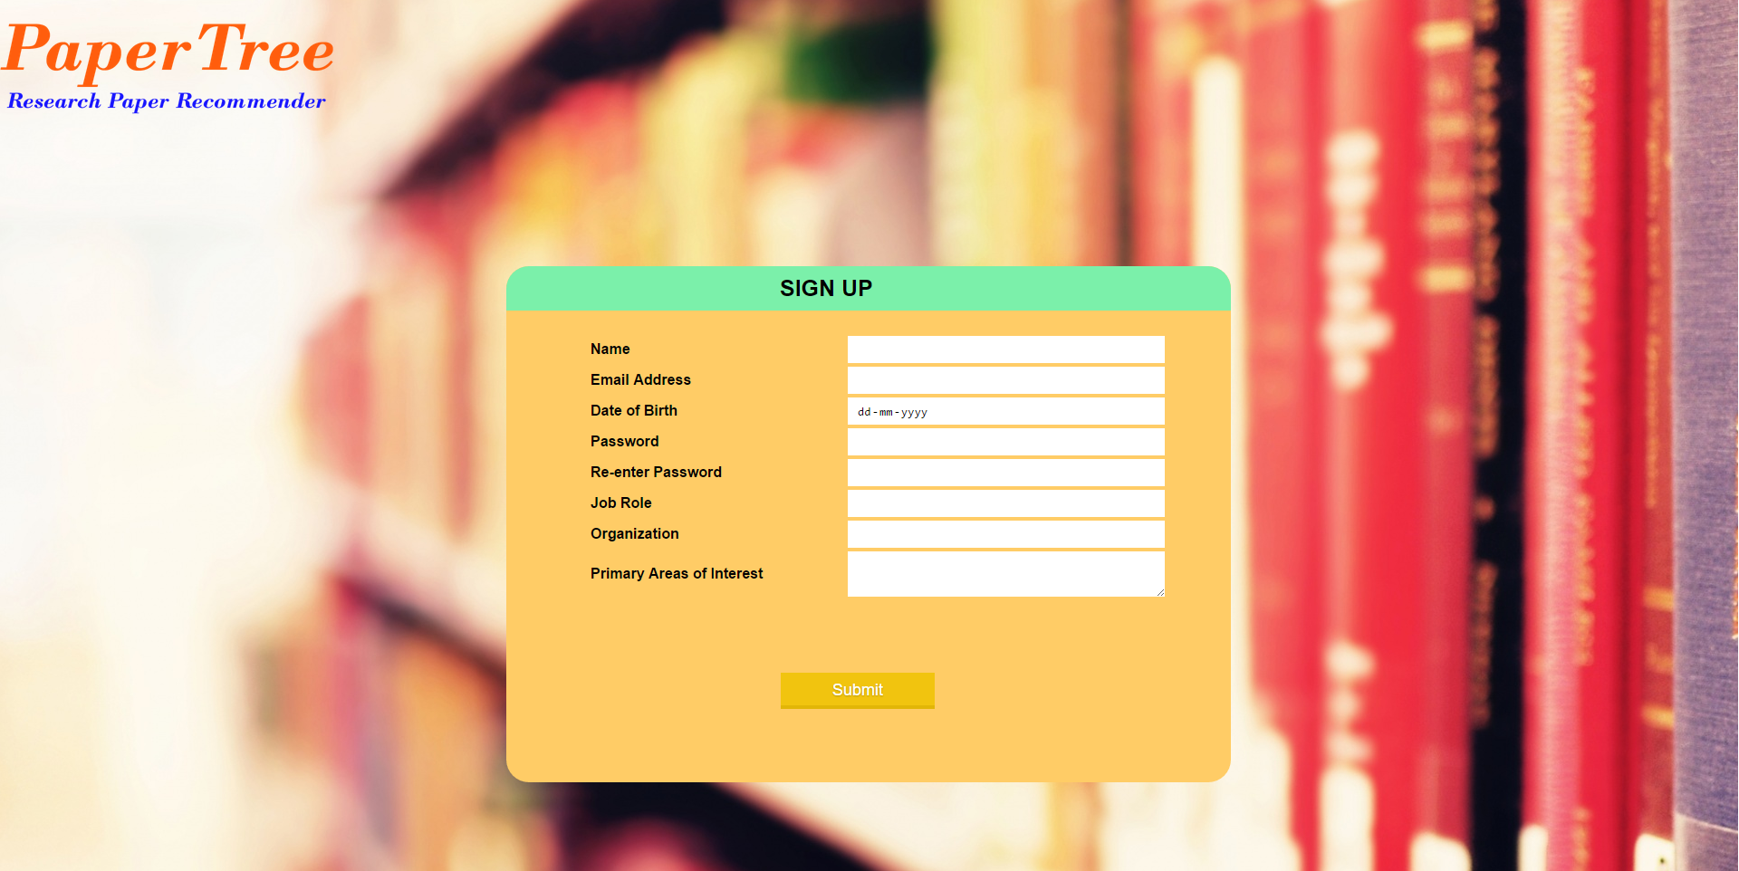
Screenshots (contd.)
Sign Up Screen:

Slide 22

Screenshots (contd.)
Search:

Slide 23
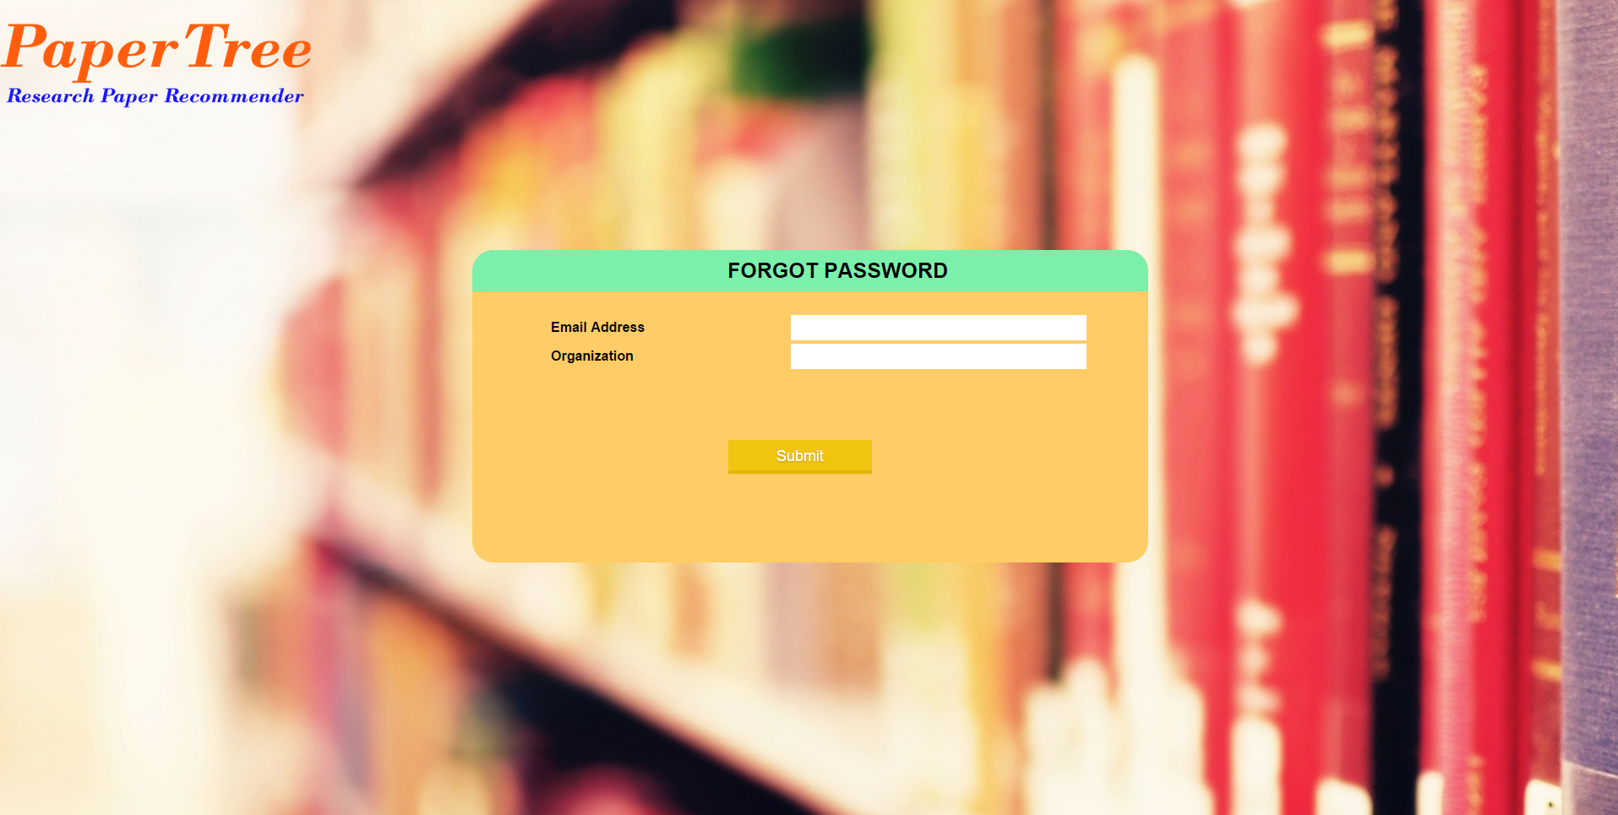
Screenshots (contd.)
Forget Password:

Slide 24
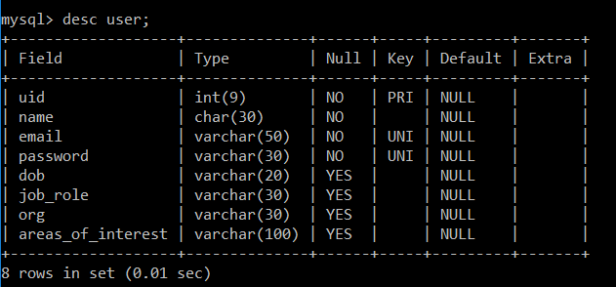
Dummy Data
User Information Table:

Slide 25
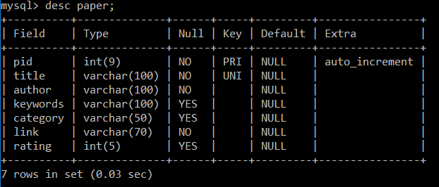
Dummy Data (contd.)
Research Paper Information Table:

Slide 26
Project Progress
GitHub Link - https://github.com/ritikaahuja/PaperTree

